Slide 1

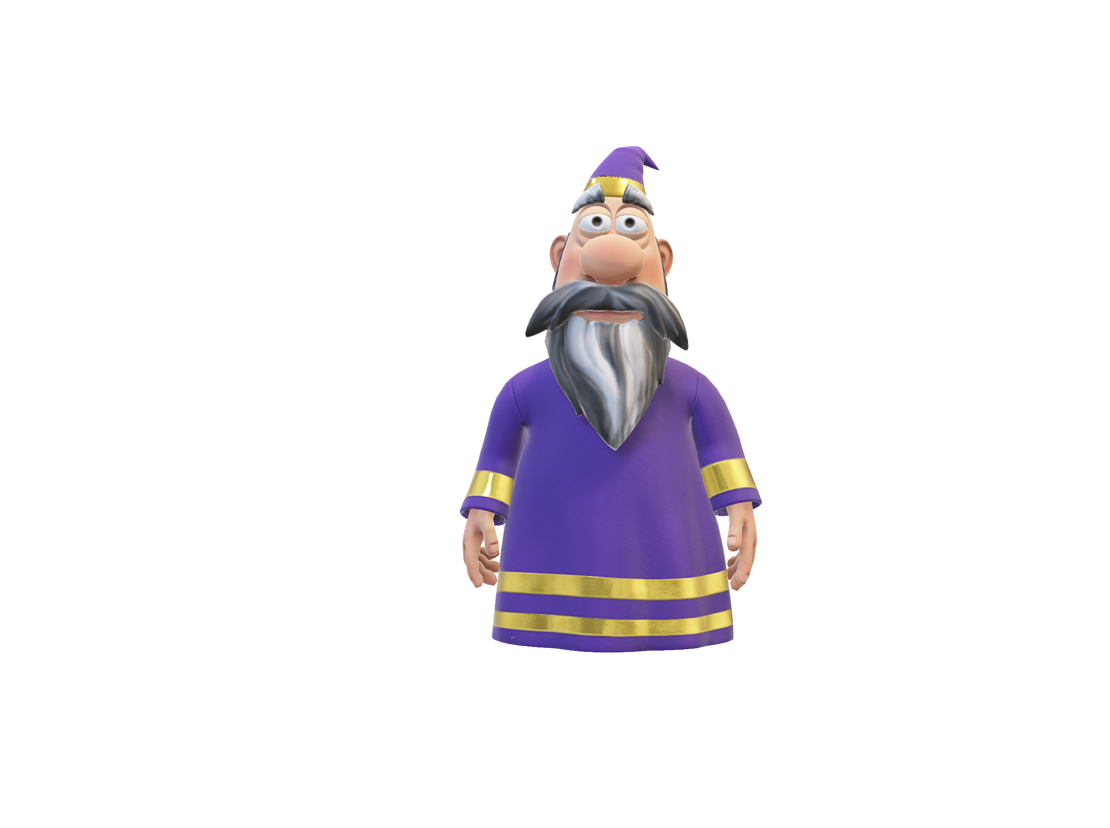

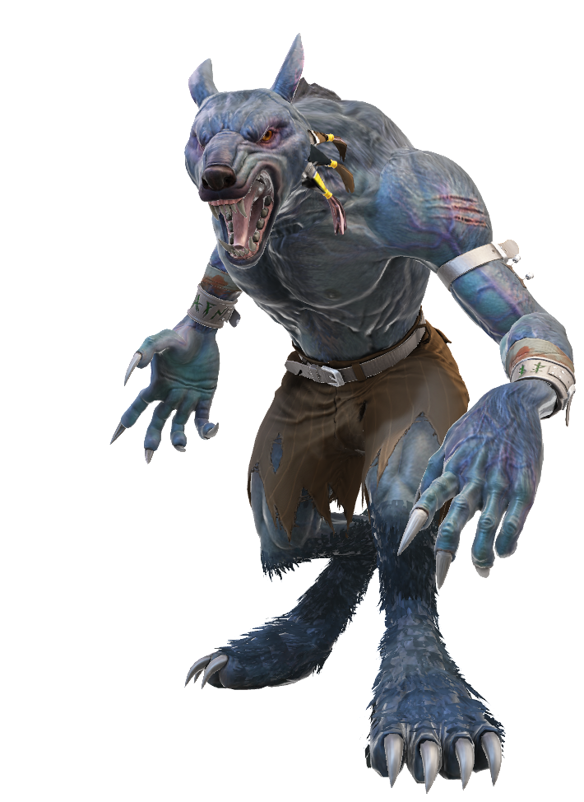
The quantum werewolf
By Ludovic Marcotte, Louis-Félix Vigneux, Wilhem Harvey and Rémy Lyscar
« compile moi si tu peux »
For the iQuCodeFest

Slide 2
The goal of the game
Two win conditions:
The village (non-werewolves players) killed all of the werewolves.
The werewolves compose more than half of the players alive.
Begin the game
Night Phase
Day phase

Slide 3

The core mechanic
Player alife
Qubit representing a player
Two phases:
The night phase
The day phase
Qubit represent the life of a player:
Player lives if state measured is |0>
Player dies if state measured is |1>
Player dead

Slide 4
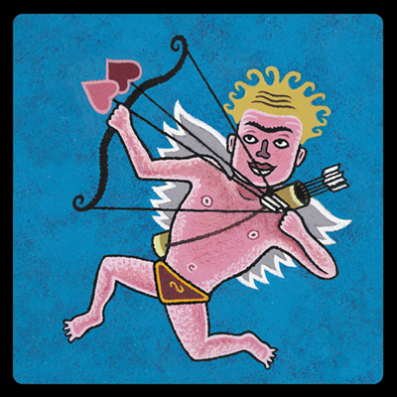

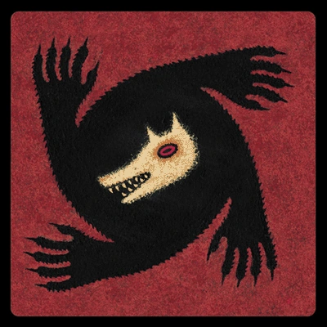


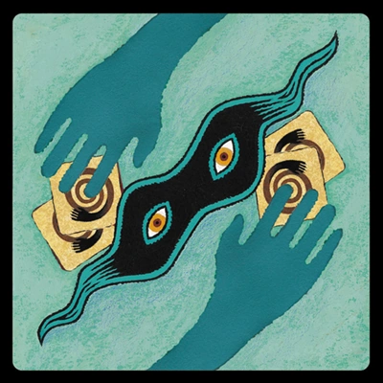
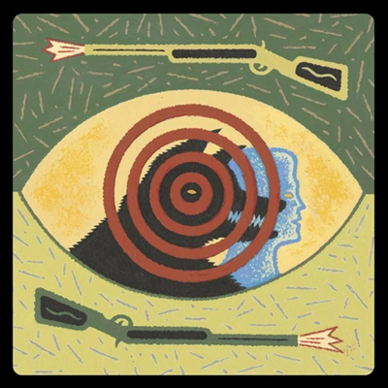



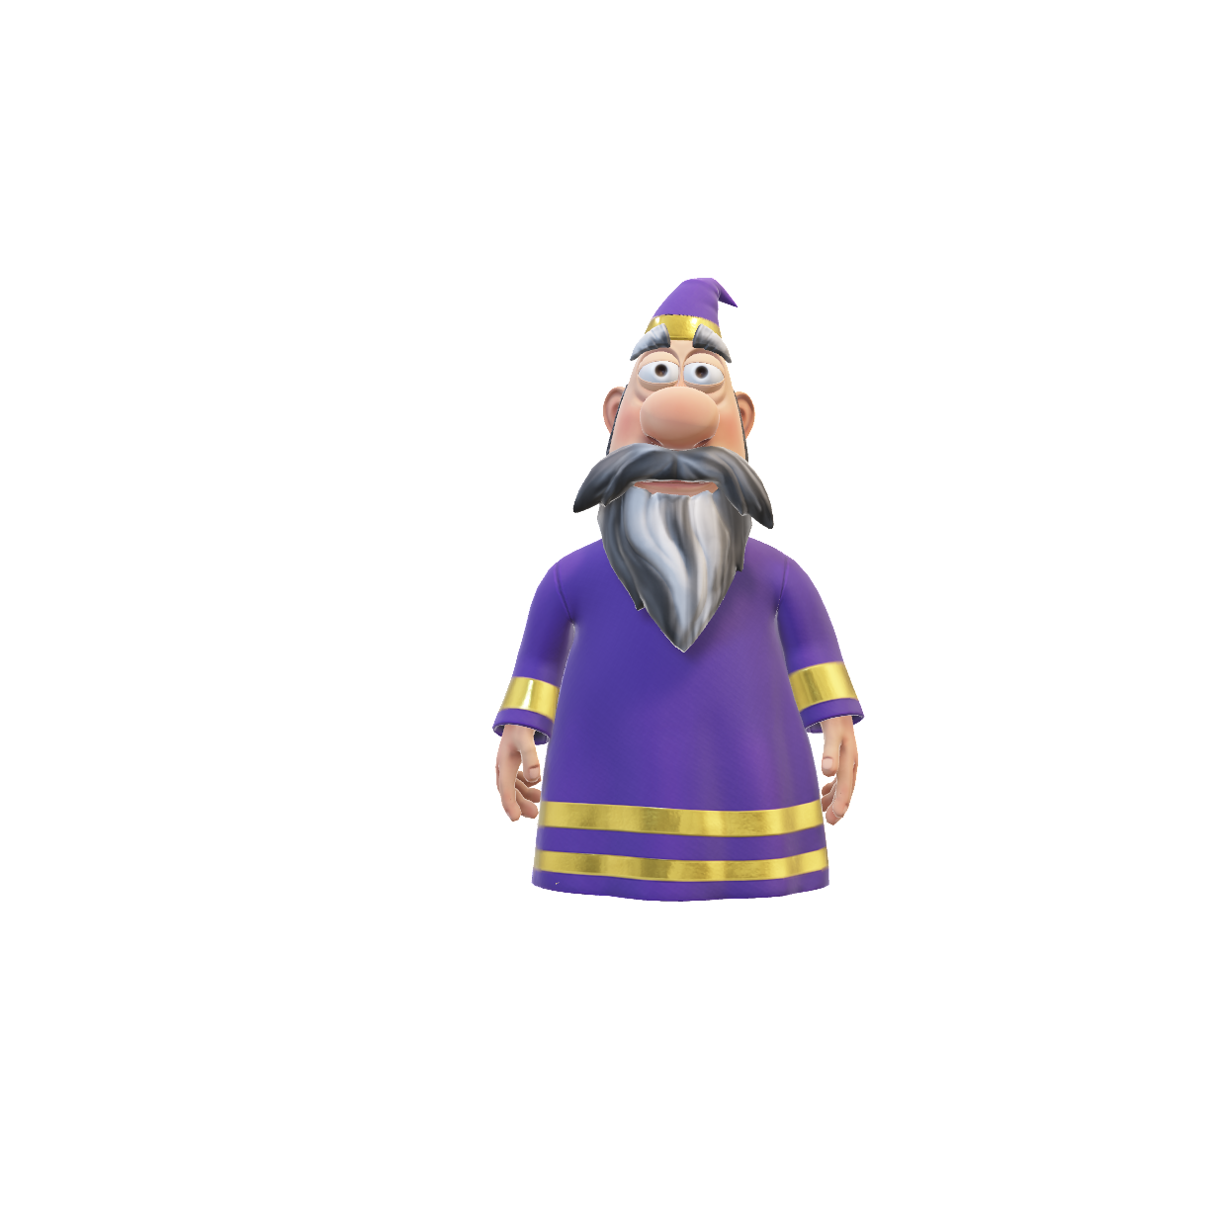
The roles
Order of the roles:
The cupid (1st turn only)
The seek
The werewolves
The witch
The saviour
The thief
* Other roles:
The hunter
The captain
The villagers

Slide 5
Explication of the quantum roles
Werewolfs
Little attack gate
The witch
Rx(π/3)
Attack gate
Rx(2π/3)
Or
Little save gate
Rx(-π/3)

Slide 6
Explication of the quantum roles
The cupid
The saviour
Entangle two players
Reset to |0>
|0><0|

Slide 7
Explication of the quantum roles
The hunter
The thief
Big attack gate when
he dies
Swap gate
Rx(ϴ)
90% probability for the targeted player to die

Slide 8
Explication of the classical roles
The captain
The seek
The villager

Slide 9
Explication of the night phase
Initiate a circuit for the players
Play all of the roles (append their gate)
Add the cnot for the lovers

Slide 10
Explication of the night phase
Qubits are measured in the morning
in the Z-basis.
Gates are applied during the night phase.
Rx(2π/3)
Rx(-π/3)
𝛼|0> + β|1>
Player 1 (role)
|0>
|1>
Player 2 (role)
|0>
|0>
𝛼|0> + β|1>
|0><0|
|0>
|1>
Player 3 (role)
𝛼|0> + β|1>
Player 4 (role)
|0>
|0>
𝛼|0> + β|1>
…
...

Slide 11
Explication of the day phase
Measure the night circuit
Vote test
Hunter triggered?

Slide 12
The vote test: instant check to see if the player dies.
|0>
Voted player
Rx(2π/3)
|0>
|0> or |1>, lives or die
|1>

